Slide 1
Virtual Memory
Module 5
ITSC205
Operating Systems Internals

Slide 2
Virtual Memory
Background
Demand Paging
Copy-on-Write
Page Replacement
Allocation of Frames
Memory-Mapped Files
Allocating Kernel Memory
Operating-System Examples

Slide 3
Objectives
Describe the benefits of a virtual memory system
Explain the concepts of demand paging, page-replacement algorithms, and allocation of page frames
Discuss the principle of the working-set model

Slide 4
Swapping
Total physical memory space of processes can exceed physical memory (RAM)
A process can be swapped (paged out) temporarily out of memory to a backing store, and then brought back into memory for continued execution
Backing store – fast disk large enough to accommodate copies of all memory images for all users; must provide direct access to these memory images

Slide 5
Swapping
Swap out, Swap in – swapping variant used for priority-based scheduling algorithms; lower-priority process is swapped out so higher-priority process can be loaded and executed
Major part of swap time is transfer time; total transfer time is directly proportional to the amount of memory swapped
System maintains a ready queue of ready-to-run processes which have memory images on disk

Slide 6
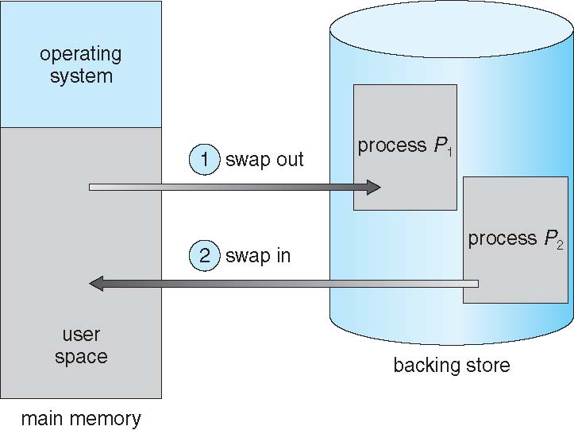
Schematic View of Swapping

Slide 7
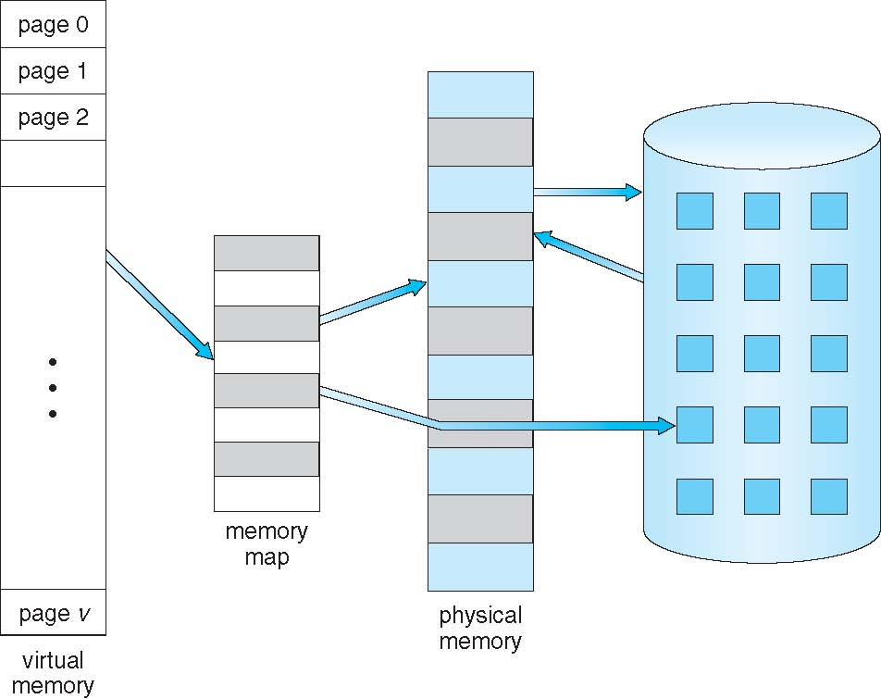
Virtual Memory That is Larger Than Physical Memory

Slide 8
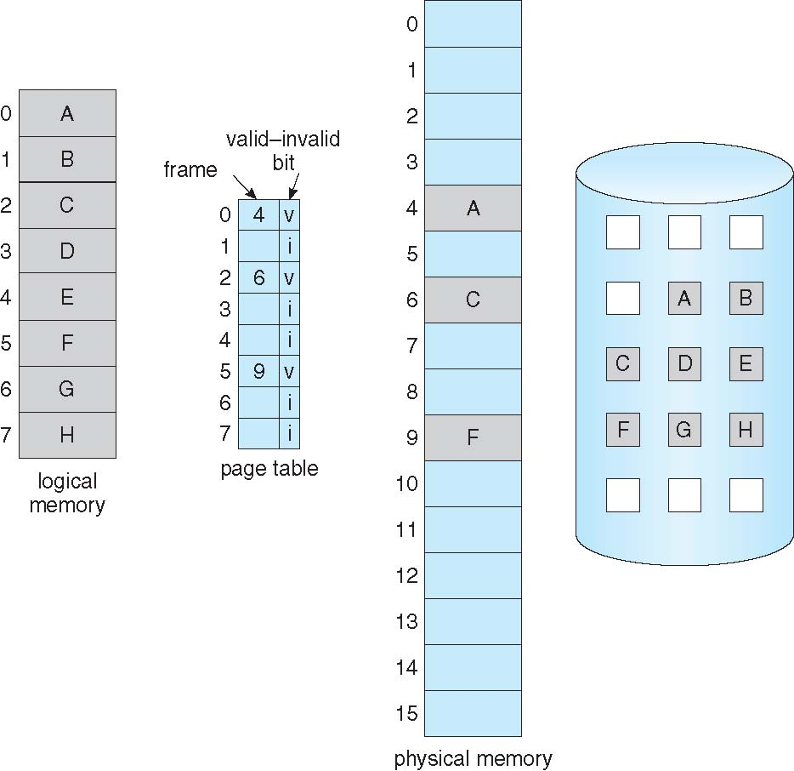
Page Table When Some Pages Are Not in Main Memory

Slide 9
Valid-Invalid Bit of PTE
If the valid bit of a PTE encountered during address translation is zero, the PTE represents an invalid page—one that will raise a memory management exception, or page fault, upon reference. The MMU ignores the remaining bits of the PTE, so the operating system can use these bits to store information about the page that will assist in resolving the page fault.
With each page table entry a valid–invalid bit is associated (v ⇒ in-memory – memory resident, i ⇒ not-in-memory)
Initially valid–invalid bit is set to i on all entries
During address translation, if valid–invalid bit in page table entry is I ⇒ page fault

Slide 10
Demand Paging
Demand paging is a common technique used in virtual memory systems, where processes located in disk are swapped into memory. But Instead of swapping the entire process, only the pages needed during the program execution are loaded into memory.
Initially RAM is empty as the CPU request pages the OS will be trap and only needed pages will be paged into RAM from the storage (hard disk)

Slide 11
Demand Paging
A page fault causes the following:
Trap to the operating system
Save the registers and process state (context switch)
Determine that the interrupt was a page fault
Check that the page reference was legal and determine the location of the page on the disk
Issue a read from the disk to a free frame:
Wait in a queue for this device until the read request is serviced
Wait for the device seek and/or latency time
Begin the transfer of the page to a free frame

Slide 12
Demand Paging
While waiting for I/O to complete, allocate the CPU to some other process
Receive an interrupt from the disk I/O subsystem (I/O completed)
Save the registers and process state for the other process (context switch)
Determine that the interrupt was from the disk
Correct the page table and other tables to show page is now in memory
Wait for the CPU to be allocated to this process again

Slide 13
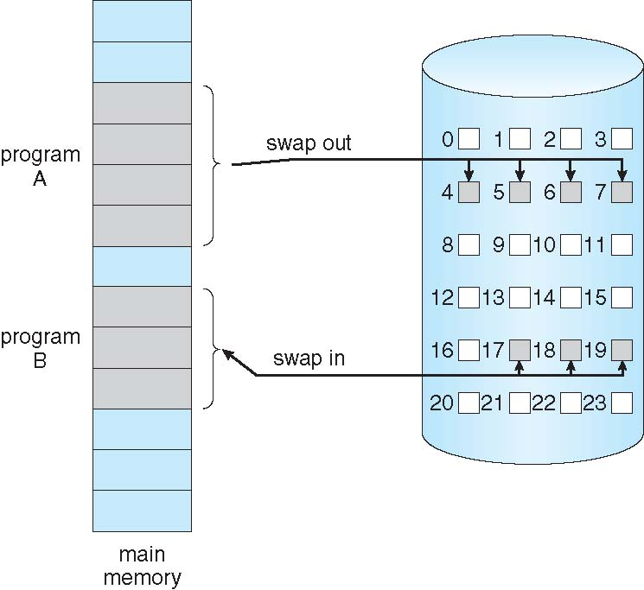
Transfer of a Paged Memory to Contiguous Disk Space

Slide 14
Page Fault
Accessing a page that isn’t resident in memory but is on disk in a page file or a mapped file
If there is a reference to a page, the first reference to that page will trap the operating system and generates a page fault
Page Fault types
Soft: page in RAM but in a different state
Hard invalid page, page located in storage (disk)

Slide 15
Page Fault
Operating system looks at another table to decide:
Invalid reference ⇒ abort
Just not in memory
Get empty frame
Swap page into frame via scheduled disk operation
Reset tables to indicate page now in memory Set validation bit = v
Restart the instruction that caused the page fault

Slide 16
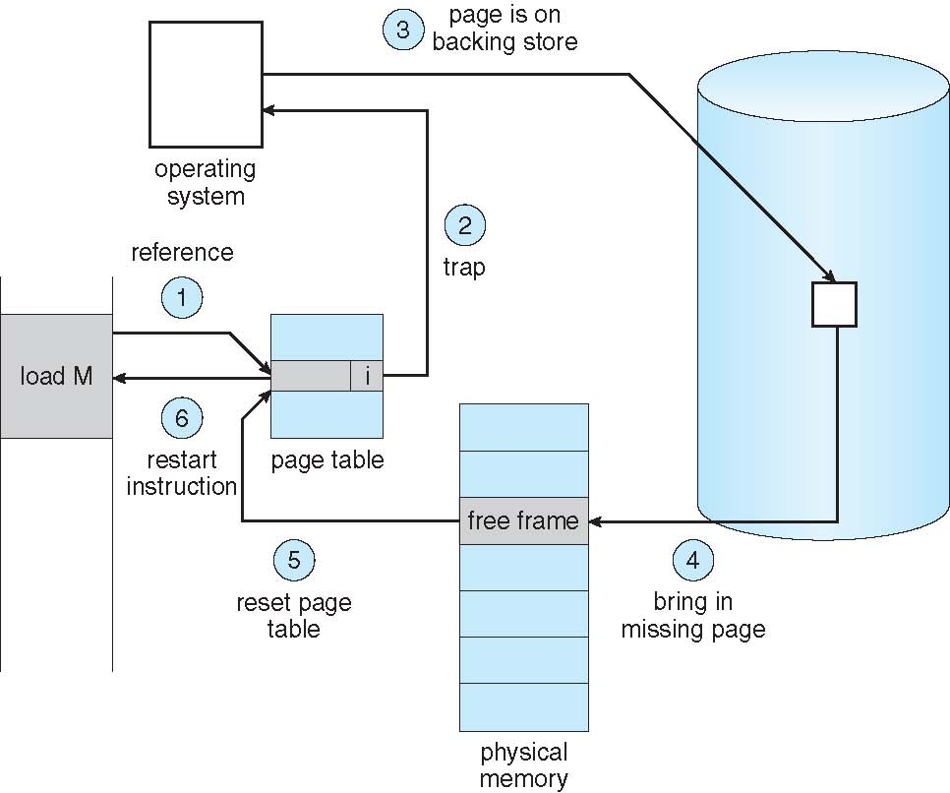
Steps in Handling a Page Fault

Slide 17
Windows Page File
Page file is used to store modified pages that are still in use by some process but have had to be written to disk. Page file space is reserved when the pages are initially committed.
The paging file is only one aspect of virtual memory. In fact, even if you run with no page file at all, Windows will still be using virtual memory.
Once the page files are open, they can’t be deleted while the system is running because the System process maintains an open handle to each page file.
Page File: \??\C:\pagefile.sys
Increasing the size of the page file does not change system performance, it simply means the system can have more committed virtual memory.

Slide 18
Windows Page File
The numeric value of system commit limit represents the amount of RAM available to Windows plus the current sizes of any page files. If a page file is expanded, or new page files are created, the commit limit increases accordingly. If no page files exist, the system commit limit is simply the total amount of RAM available to Windows.
Commit charge is the system-wide total of all “committed” memory allocations that must be kept in either RAM or in a paging file
If the page file is too small for the mix of applications you are running, you might get the “system running low on virtual memory” error message. In this case, first check to see whether a process has a memory leak.

Slide 19
Windows Commit Limit and Working Set
Commit Limit: Number of bytes of virtual memory that can be committed without having to extend the paging files; if the paging files can be extended, this limit is soft.
Working Set: set of memory pages touched recently by the threads within a process. Virtual Bytes that is currently in RAM and can be referenced without a page fault. The working set changes if the page is active, it will stay in the working set, if it is not longer in use, it is dropped from working set.

Slide 20
Protecting Memory
Windows provides memory protection so that no user process can corrupt intentionally or unintentionally the address space of another process or the operating system. Windows provide four ways to protect memory
All system-wide data structure and memory pools used in kernel-mode cannot be access by user-mode threads. If a user-mode thread tries to access it the hardware generates a fault and the system reports an access violation
Each process has its own private address space when is created and only threads that belong to the process can access it. Windows controls the translation of virtual-physical address to ensure that only the threads within the process access the legal address.

Slide 21
Protecting Memory
Windows provide hardware-control protection such as read/write or read-only. Windows API memory protection options
Shared memory section objects have access control list(ACLs). This is checked when a process tries to access the objects

Slide 22
Copy-on-Write Page
Copy-on-Write (COW) page protection is an optimization technique used by memory manager to conserve physical memory.
Copy-on-Write (COW) allows both parent and child processes to initially share the same pages in memory. If either process modifies a shared page, only then is the page copied
COW allows more efficient process creation as only modified pages are copied
vfork() variation of fork() system call has parent suspended and a child using copy-on-write address space of parent.

Slide 23
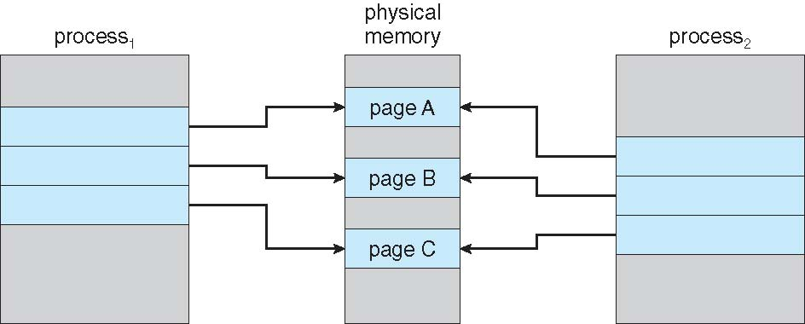
Before Process 1 Modifies Page C

Slide 24
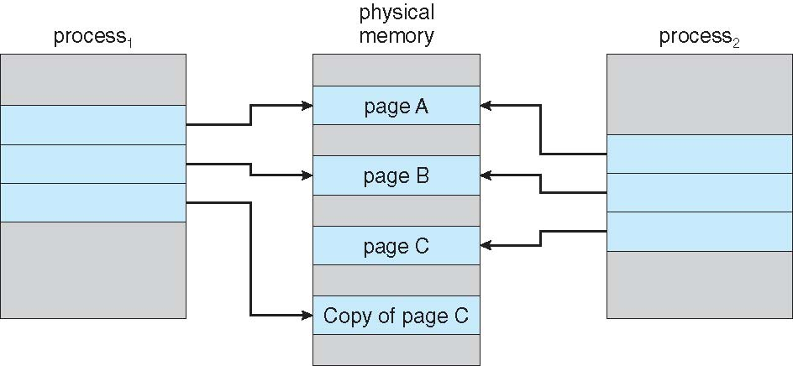
After Process 1 Modifies Page C

Slide 25
Page Table Entries Flags and Protection bits
Windows Internals Part 7 –Memory Management

Slide 26
Data Execution Prevention -DEP
DEP is a mechanism to protect pages “ No Execute” -Nx . The attempt to execute a page with a flag marked as “ No-Execute” will cause an access fault.
If an attempt is made in kernel mode to execute code in a page marked as no-execute, the system will crash with ATTEMPT_EXECUTE_OF_NOEXECUTE_MEMORY bug check code.
In user mode will generate an exception delivered to the thread attempting the illegal reference. STATUS_ACCESS_VIOLATION

Slide 27
Data Execution Prevention -DEP
On 64 bits Windows execution protection is applied to user and kernel mode threads’ stack.
DEP prevents types of malware from exploiting bugs in the system through the execution of code located in the stack
For older processor without hardware execute protection, Windows supports Software DEP that reduces the exploit of exception handling mechanism

Slide 28
Windows API – Memory Protection
PAGE_NOACCESS
PAGE_READONLY
PAGE_READWRITE
PAGE_EXECUTE
PAGE_WRITECOPY
PAGE_EXECUTE_WRITECOPY

Slide 29
Address Space Layout Randomization (ASLR)
The address of threads stack, process heap and loaded images such as DLLs and executables are dynamically calculated via mechanism know as ASLR.
Windows randomizes the address space of the text section as follows: the load offset is calculated by computing a delta value each time an executable is loaded. This value is a pseudo-random 8-bit number from 0x10000 to 0xFE0000, calculated by taking the current processor’s time stamp counter (TSC), shifting it by four places, and then performing a division modulo 254 and adding 1. Then this number is multiply by 64K

Slide 30
ASLR
Since Windows code and data are placed at dynamic locations, an attacker cannot typically hardcode a meaningful offset into either a program or a system-supplied DLL.

Slide 31
What happens if there is no Free Frame?
Page replacement algorithm– If no page frame is free, find some page in memory that is not currently in used and free it, page it out
Performance – want an algorithm which will result in minimum number of page faults
Evaluate algorithm by running it on a particular string of memory references (reference string) and computing the number of page faults on that string.
String is just page numbers, not full addresses
Repeated access to the same page does not cause a page fault
Same page may be brought into memory several times

Slide 32
Global vs. Local Allocation
Global replacement – process selects a replacement frame from the set of all frames; one process can take a frame from another process
But then process execution time can vary greatly
But greater throughput, so it is more common
Local replacement – each process selects from only its own set of allocated frames
More consistent per-process performance
But possibly underutilized memory

Slide 33
Page Replacement
Page replacement algorithm:
1. Find the location of the desired page on disk
2. Find a free frame: - If there is a free frame, use it - If there is no free frame, use a page replacement
algorithm to select a victim frame - Write victim frame to disk if dirty

Slide 34
Page Replacement
3. Bring the desired page into the (newly) free frame; update the page and frame tables 4. Continue the process by restarting the instruction that caused the trap
The modify (dirty) bit is set by hardware whenever any byte in the page is written into, indicating that the page has been modified. When a page is selected for replacement, the system examines modified bit to decide if the page has to be written to disk or not. This technique reduces overhead of page transfers – only modified pages are written to disk

Slide 35
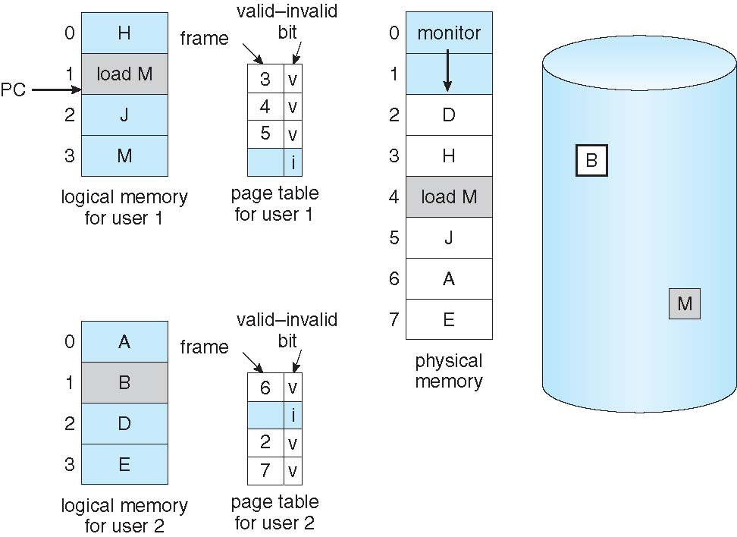
Need For Page Replacement

Slide 36
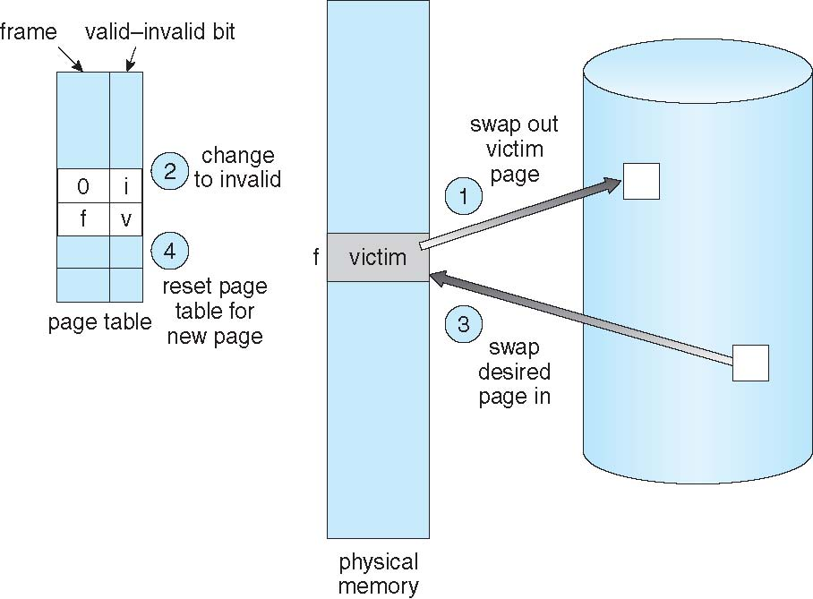
Page Replacement

Slide 37
Page and Frame Replacement Algorithms
FIFO
LRU (Least Recently Used )

Slide 38
FIFO
First-in, first-out (FIFO)
Treats page frames allocated to a process as a circular buffer
Simplest replacement policy to implement
Page that has been in memory the longest is replaced

Slide 39
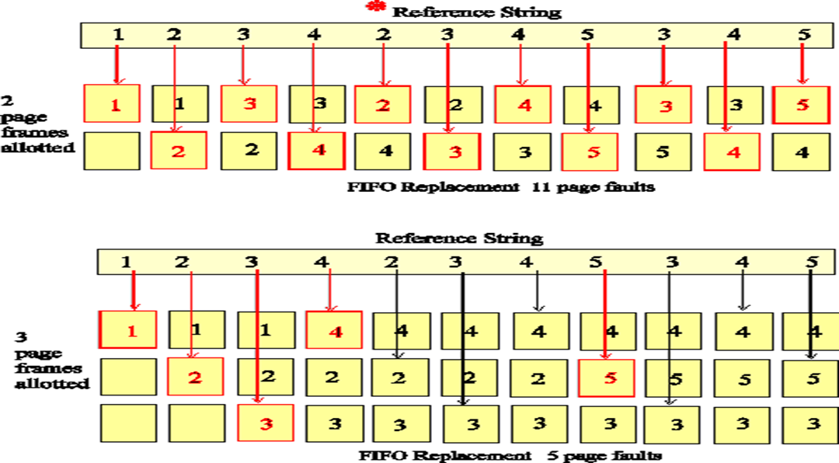
FIFO Replacement

Slide 40
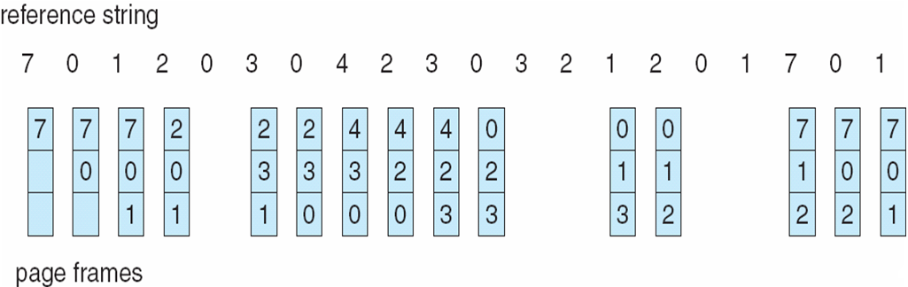
FIFO Page Replacement

Slide 41
Least Recently Used LRU
When a page must be replaced, LRU chooses that page that has not been used for the longest period of time
Use past knowledge rather than future
Generally good algorithm and frequently used
To implement LRU is necessary to keep a stack of page numbers with the most recently used page on the top and the LRU at the bottom
Counters- clock incremented for every memory reference
Notes:
The Least Recently Used replacement policy chooses to replace the page which has not been referenced for the longest time. This policy assumes the recent past will approximate the immediate future. The operating system keeps track of when each page was referenced by recording the time of reference or by maintaining a stack of references.
LRU is a stack algorithm removal policy – increasing main memory causes either a decrease in or same number of page interrupts.
LRU doesn’t have same anomaly that FIFO does.
The LRU algorithm looks at all three bits in the PMT before deciding which pages to swap out. (Text Book page 61)
LRU can be implemented with
counters : whenever a reference to a page is made , the contents of the clock register are copied to the time-of use field in the page table entry for that page. In this way, the system always have the time of the last reference to each page.
Stack:the top of the stack is always the most recently used page and the bottom is the LRU (example on next slide)
Text Book Page 59

Slide 42
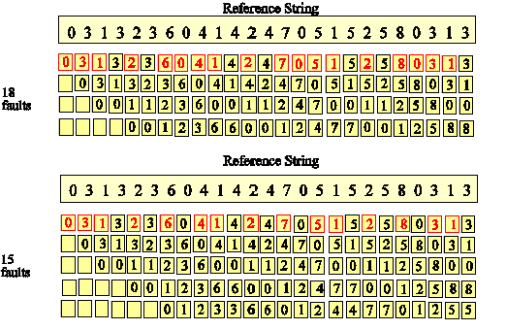
LRU Replacement
Notes:
The Least Recently Used diagram above illustrates the LRU algorithm.
Notice that the most recently accessed page is now represented by the top page rectangle. The rectangles do not represent specific page frames as they did in the FIFO diagram. Thus, each reference necessitating a page fault (shown in red) is now on the top row.
Further inspection will show that as more pages are allotted to the program the page references in each row do not change. Only the number of page faults changes. The set of pages in memory for n pages is thus a subset of the set of pages for n + 1 page frames. In fact, the diagram could be considered a STACK data structure with the depth of the stack representing the number of page frames. If a page is not on the stack (i.e. is found a depth greater than the number of page frames) then a page fault occurs.
Reference: http://cne.gmu.edu/modules/vm/yellow/lru.html
More examples in the Text Book pages 59 and 60

Slide 43
Windows Page Frame states

Slide 44
Allocating Kernel Memory
Treated differently from user memory
Often allocated from a free-memory pool
Kernel requests memory for structures of varying sizes
Some kernel memory needs to be contiguous
I.e. for device I/O
Two techniques use to allocate kernel memory
Buddy System allocator
Slab allocator

Slide 45
Buddy System
Allocates memory from fixed-size segment consisting of physically-contiguous pages
Memory allocated using power-of-2 allocator
Satisfies requests in units sized as power of 2
Request rounded up to next highest power of 2
When smaller allocation needed than is available, current chunk split into two buddies of next-lower power of 2
Continue until appropriate sized chunk available

Slide 46
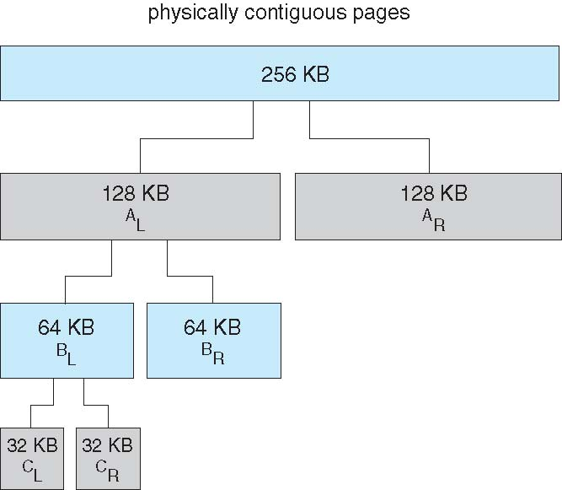
Buddy System Allocator

Slide 47
Slab allocator
Slab is one or more physically contiguous pages
Cache consists of one or more slabs
Single cache for each unique kernel data structure
Each cache filled with objects – instantiations of the data structure
When cache is created is filled with objects marked as free
When data structures are stored, objects are marked as used
If slab is full of used objects, next object allocated from empty slab
If no empty slabs, new slab allocated
Benefits of slab allocator includes:
no fragmentation
fast memory request and access

Slide 48
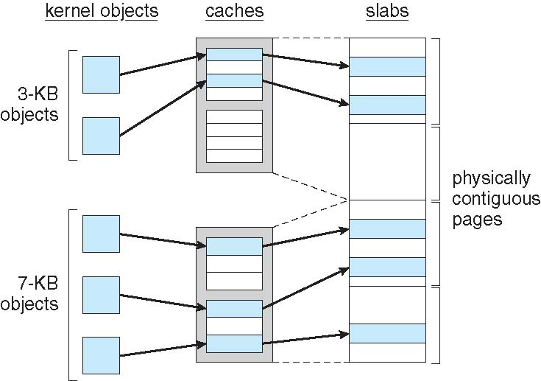
Slab Allocation

Slide 49
References
Operating System Concepts. Silberschatz, Galvin, Gagne. Latest Version. John Wiley & Sons.
All images are ©2016 Southern Alberta Institute of Technology unless otherwise indicated.

